Slide 1
Compiler
Forth phase
Intermediate Code Generation
nearby low-level or machine
should have two important properties:
easy to produce.
easy to translate into the target machine.

Slide 2
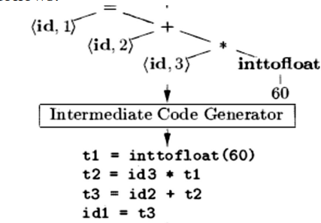
Compiler

